Slide 1

Smart Campus System
Graduation Project, 16 July 2022

Slide 2
Team Members
Ibrahim Saber Mohamed
Ahmed Nasser Ahmed
Ahmed Mahmoud Mohamed
Taqwa Hamed Goda
Kholoud Khaled Atia
Radwa Refaat Galal
Yasmeen Mohamed Saad

Slide 3
Supervisors
Dr. Abdelhamid Ashraf
Dr. Fathy Farag
Faculty of Engineering ,Zag zig University

Slide 4

Smart Cities
A big part of this ICT framework is an intelligent network of connected objects and machines (also known as a digital city) transmitting data using wireless technology and the cloud.

Slide 5
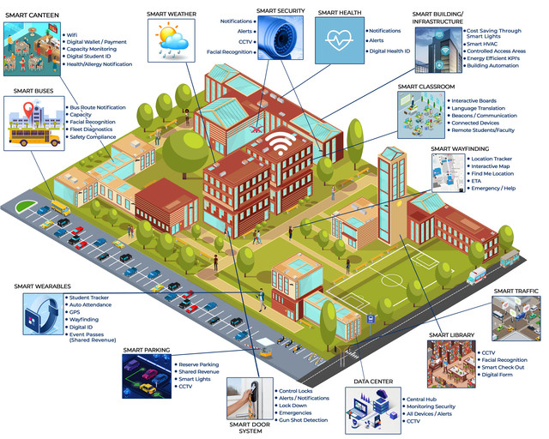
Smart Campus
Smart Campus is a part of Smart City.

Slide 6
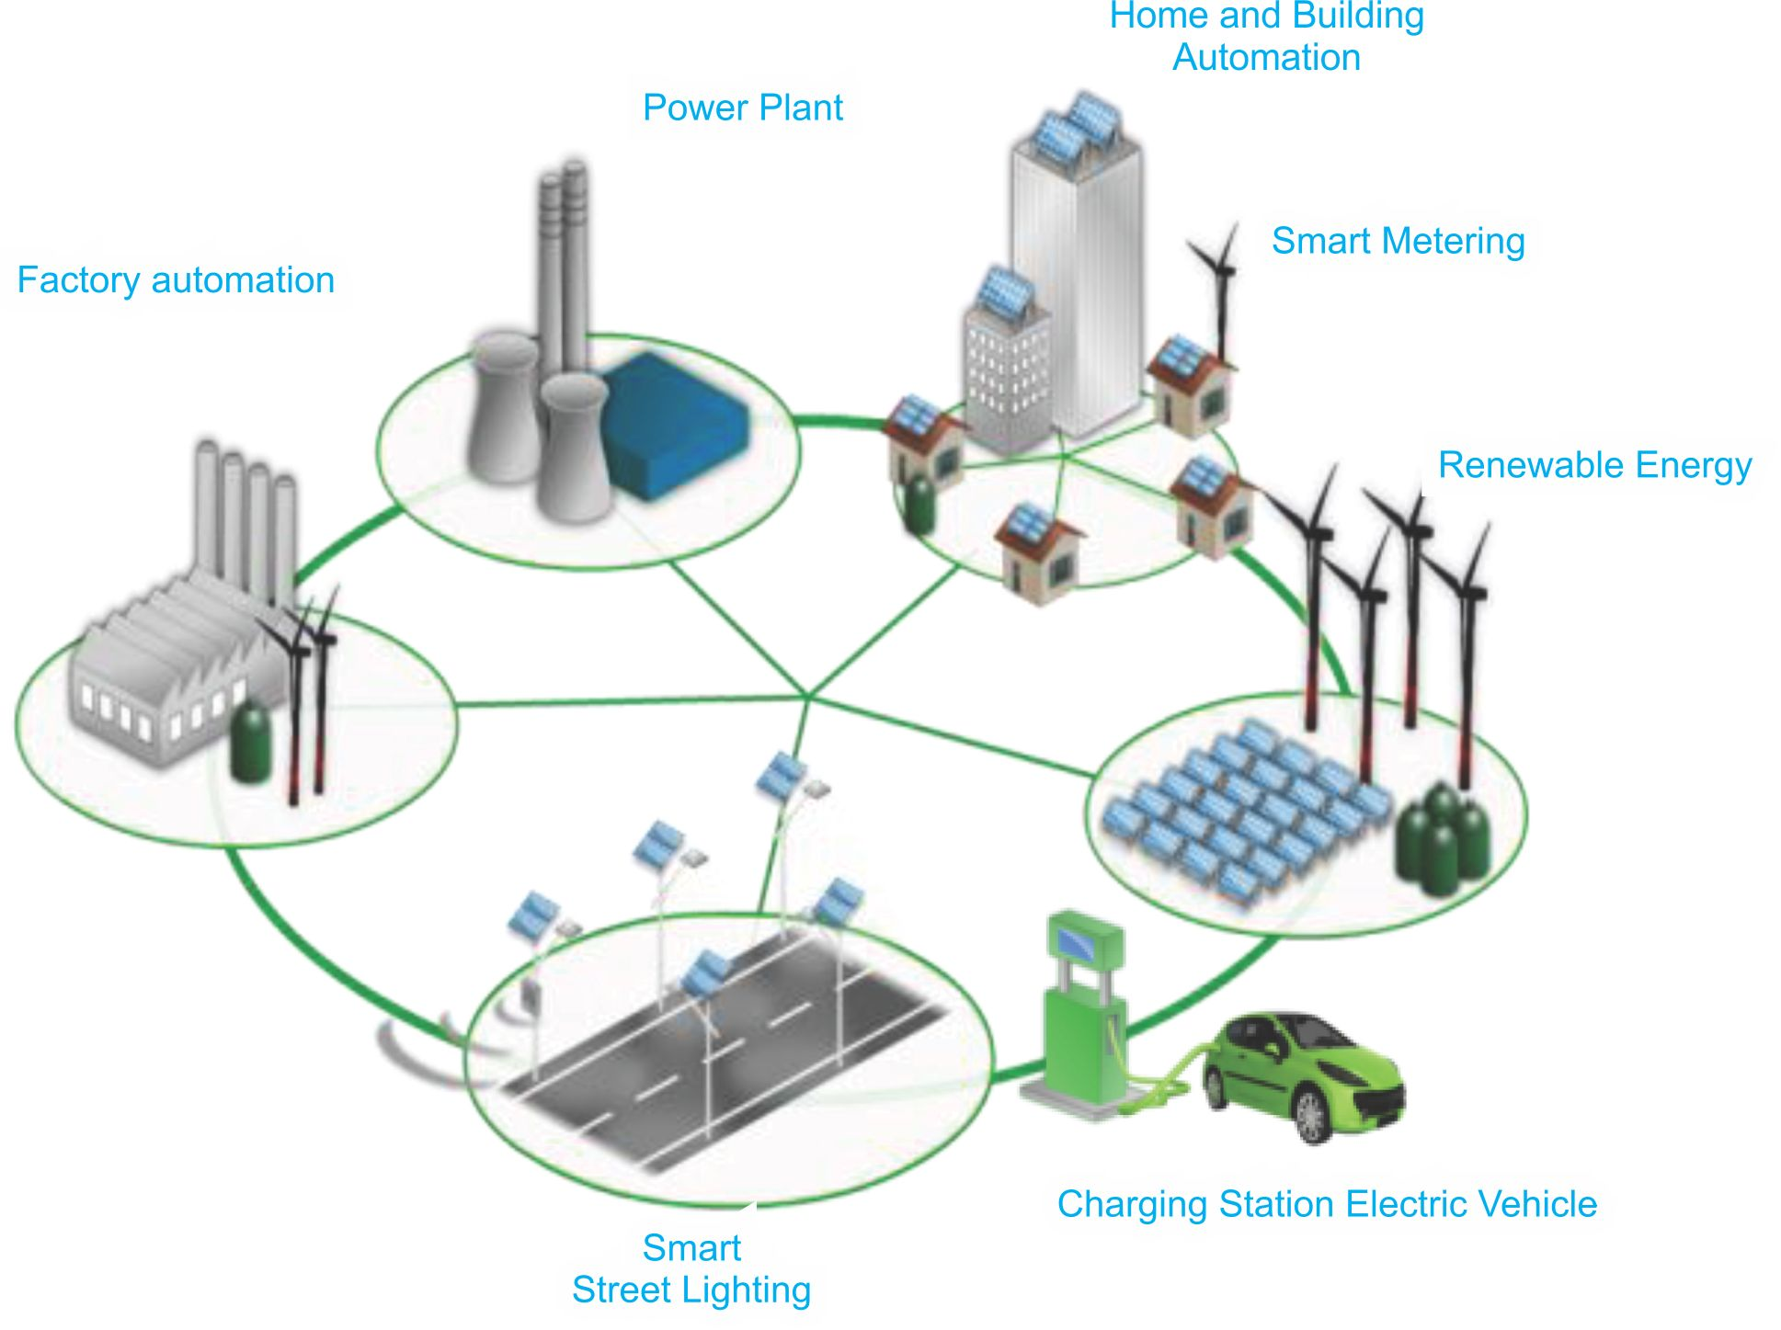

Slide 7
Smart Campus
Smart Lighting
Smart metering
Smart Attendence
Smart health care
Smart Parking
Smart Campus System is divided to five Subsystems We will Discus them on the next slides.

Slide 8
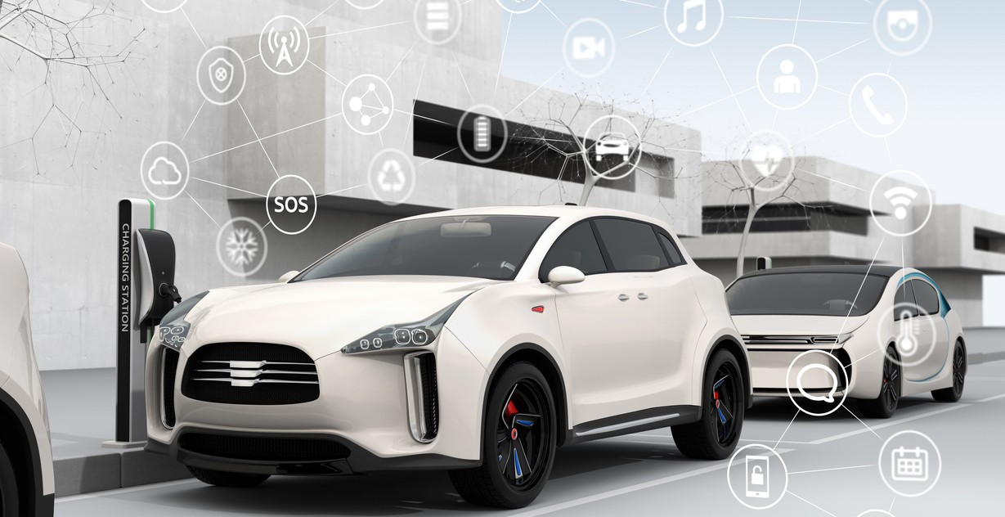
The Problem :
When the user needs to park his car it causes waste of time in searching the parking spot, reducing traffic congestion.
The Solution :
We try to solve this problem by creating The Smart Parking that allows the user quick access which helps in the reduction of time in searching the parking spot, reducing traffic congestion. It can be used to monitor parking systems and exhibit the parking lot situation at any given moment.

Slide 9

The Problem :
The degree of light may be not enough and accidents occurring in the nighttime is either caused by driver errors or malfunctioning streetlights The malfunctions can be caused by fused bulbs or damaged wiring.
The Solution :
We solve this problems by the Smart Light System and this system can increase the accuracy and efficiency of street lighting, and therefore solve the problem of accidents.

Slide 10
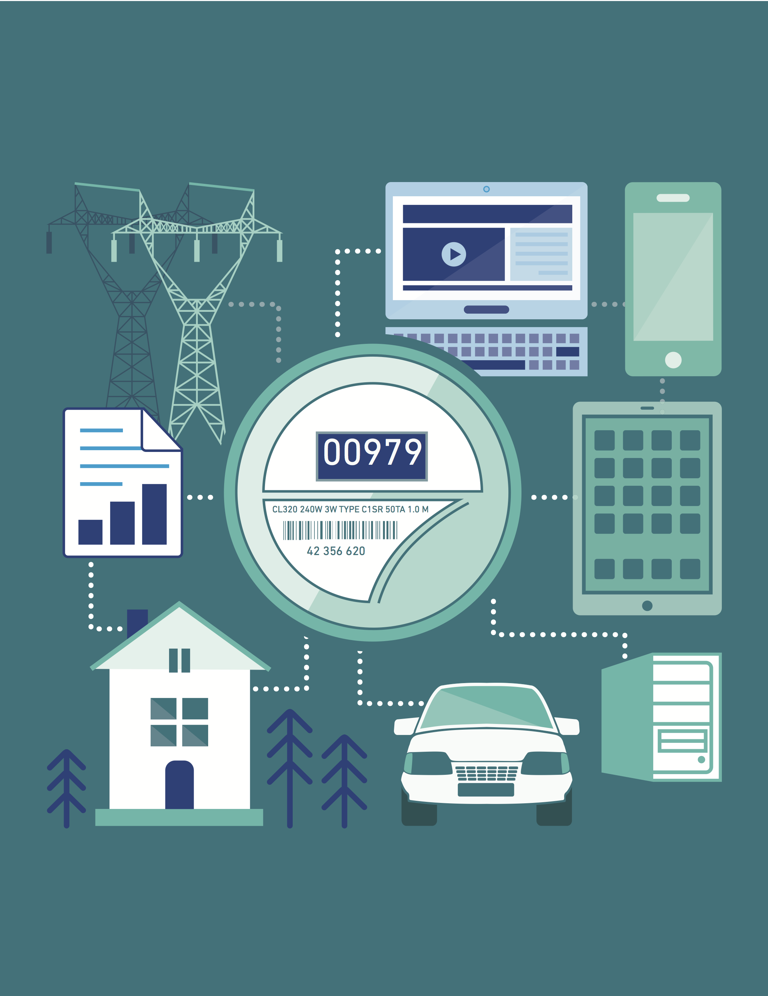
The Problem :
any user needs to know how much every device consumed power and the result of voltage and current flows through it and the user can have the enough time to solve any problem before any drop.
The Solution :
We solve this problem by Smart Metering System It records information about the consumption of electric energy. then communicate the information to the consumer for greater clarity of consumption behavior,and electricity suppliers for system monitoring and customer billing.

Slide 11

The Problem :
the teacher or doctor needs to take the attendance of the students in the hall and it waste large time.
The Solution : we solve this problem by The Auto Attendance System by using the face recognition algorithm for recording the attendance of students in a classroom. The idea of the project is very helpful so the doctor to have an excel sheet with the student attending the lecture.

Slide 12

The Problem :
during this disease and corona virus we must keep our healthy and protect people around us from infection.
The Solution :
we solve this by Mask Detection System. It detects whether people wear a mask or not. This is to control the infection in cases of pandemics.

Slide 13
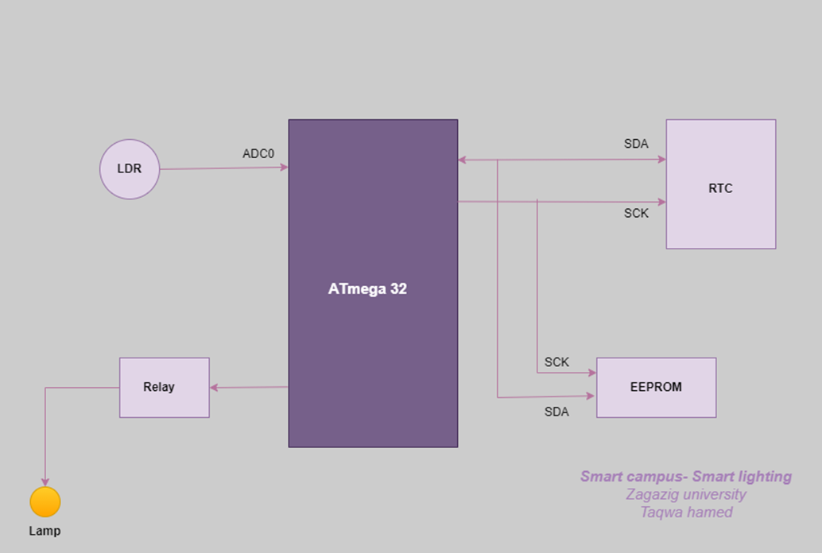
1- Smart Lighting system
In this system we will solve the problem of accidents occurring in the nighttime is either caused by driver errors or malfunctioning streetlights The malfunctions can be caused by fused bulbs or damaged wiring. This project reduces this error hence reducing accidents significantly.
Also, Manual control is prone to errors and leads to energy wastage, and manually controlling during midnight is impracticable. Where the Smart Street Lighting System is an
advanced lighting system that is designed to increase the accuracy and efficiency of the streetlight by timed controlled Switching.

Slide 14
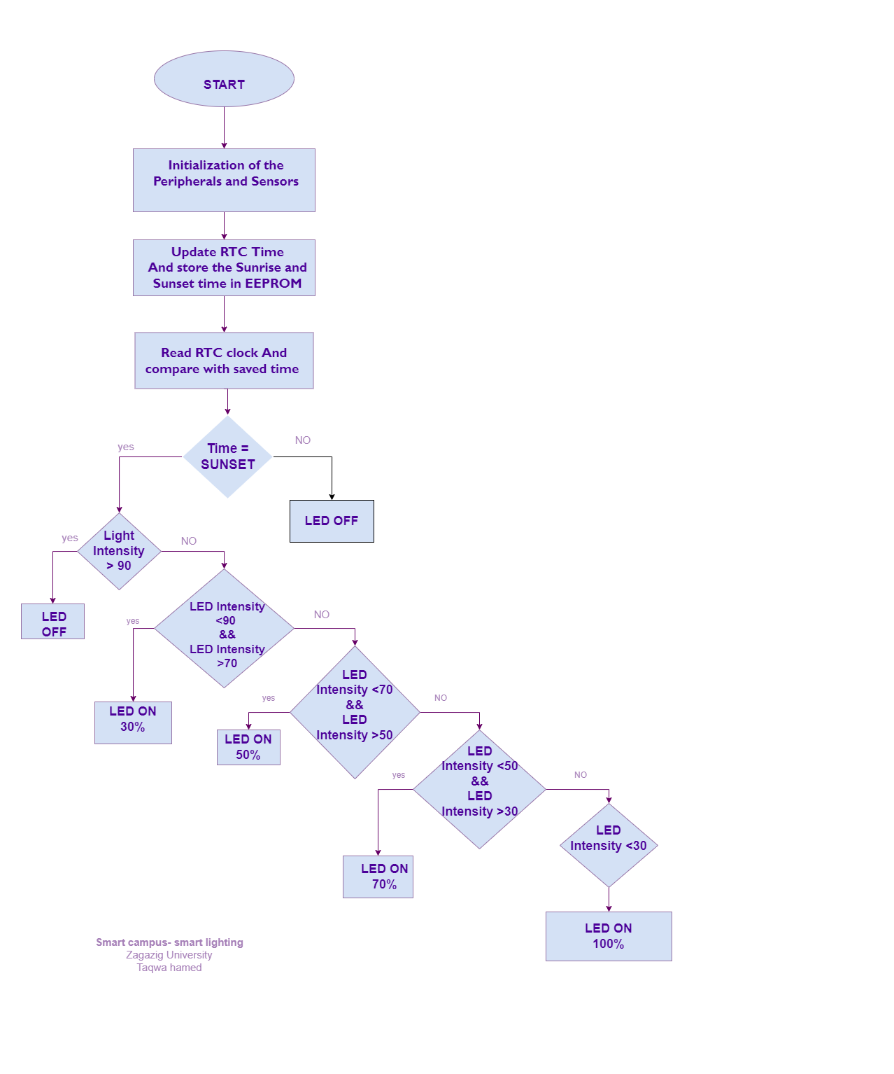
System Flow Chart

Slide 15
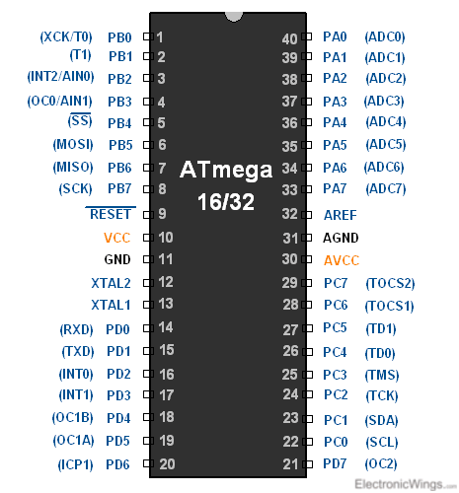
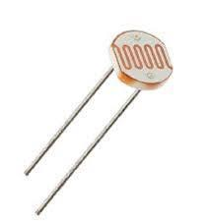
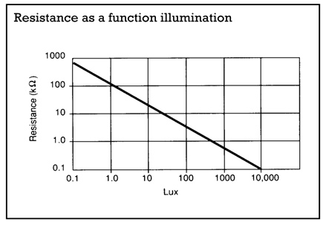
Hardware tools
1-Microcontroller ATmega32 2- LDR Sensor

Slide 16
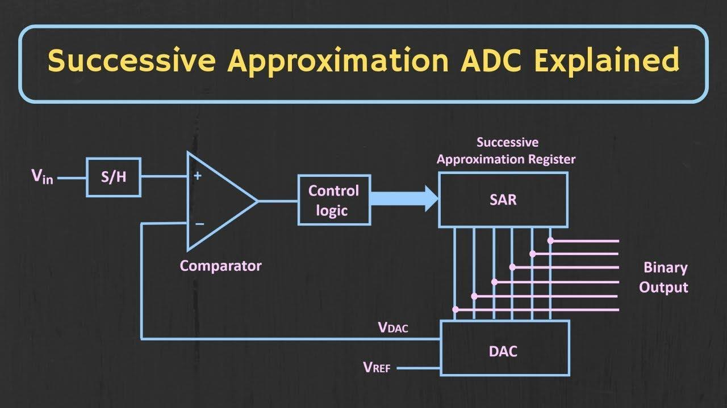
3- ADC

Slide 17
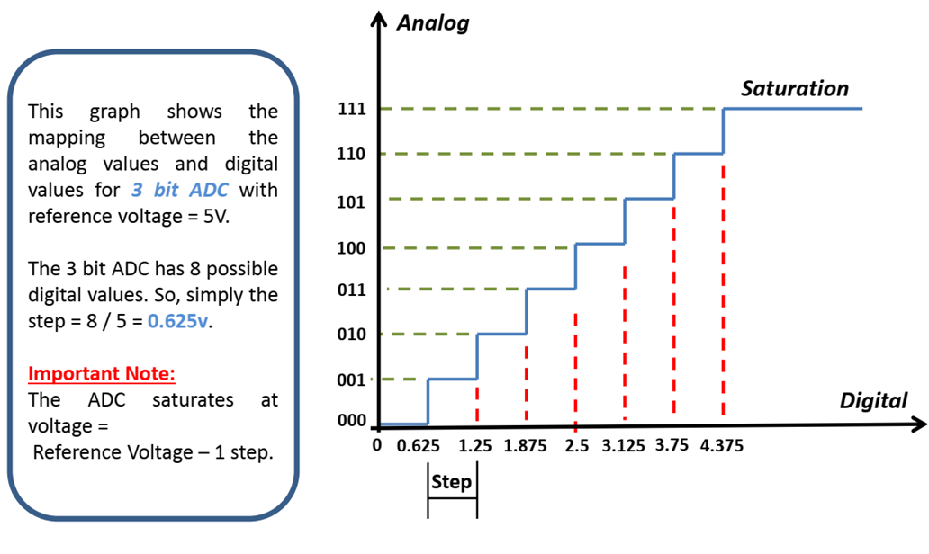
Successive Approximation ADC (SAR ADC) Its basic idea depends on a counter that counts on a clock signal called ADC Clock and with every count it increases a compare analog signal voltage value that is compared to the input signal, the counter stops counting when the compared signal is approximately equal to the input signal. Then the counter value represents the digital value of the input signal

Slide 18
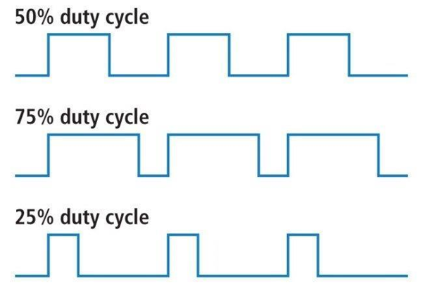
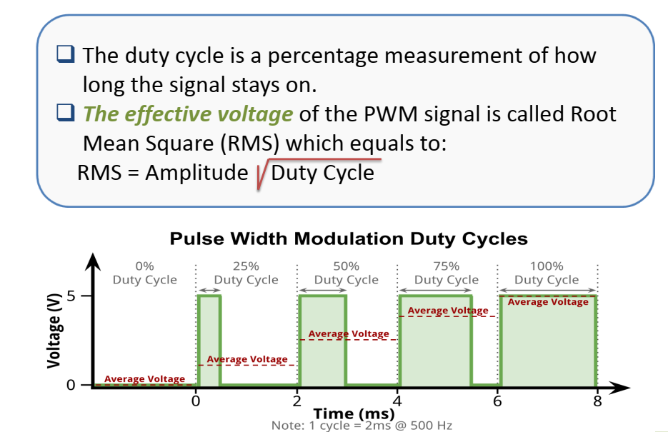

- The Duty Cycle is the percentage measurement of how long the signal stays on. - The effective voltage of the PWM signal is called root mean square (RMS) which equals to : RMS = Amplitude$\sqrt{\text{Duty} \text{Cycle}}$
4- PWM

Slide 19
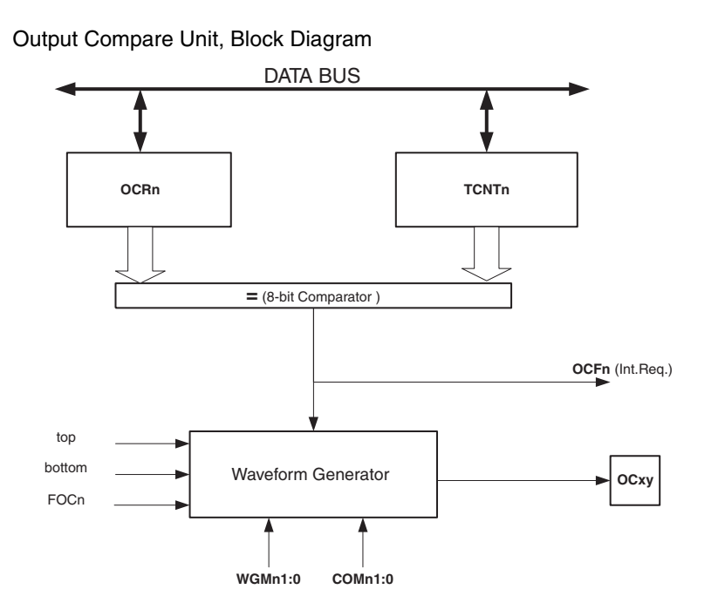
PWM Circuit
PWM
Fast PWM
Phase correct
PWM

Slide 20
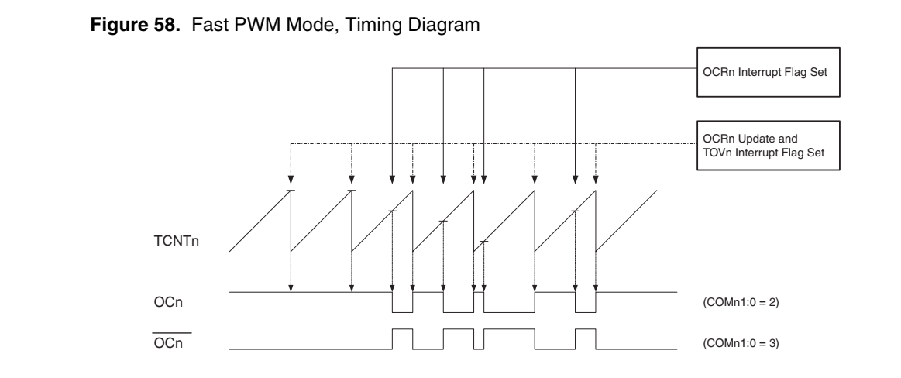
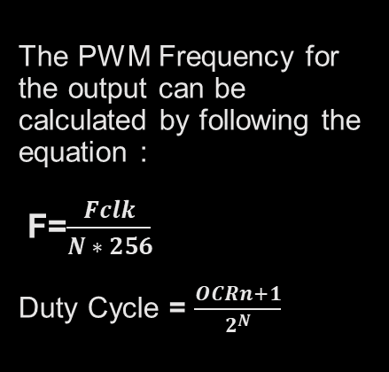
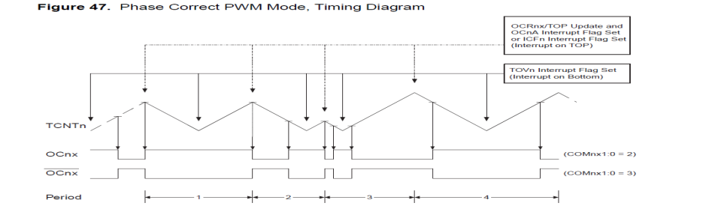
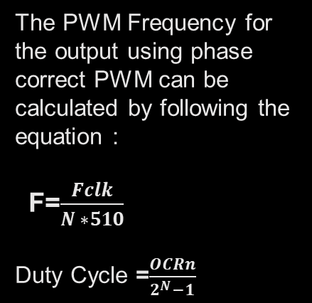
The PWM Frequency for the output using phase correct PWM can be calculated by following the equation : F=$\frac{Fclk}{N ∗510}$
Duty Cycle =$\frac{OCRn}{2^{N}−1}$

Slide 21
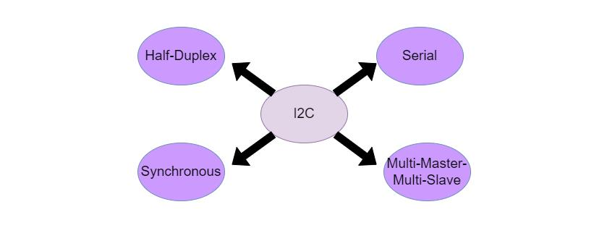
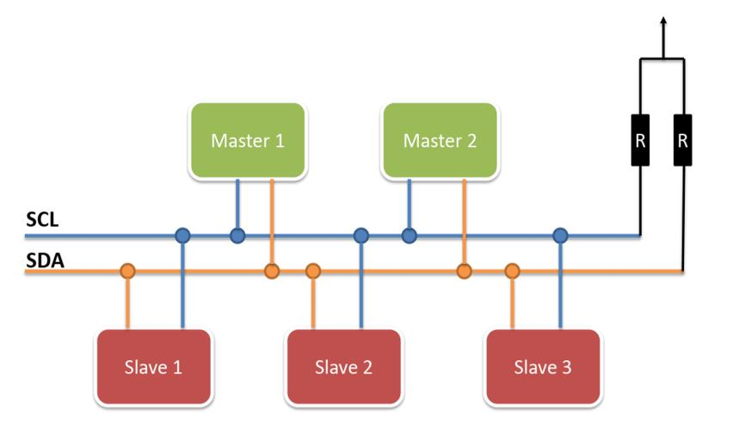
5- I2C
Inter-Integrated Circuit I²C (Pronounced I Two C or I Squared C), is a serial
communication protocol in which the devices are hooked up to the I2C bus with just two
wires.
❖ It is sometimes referred to as a Two-Wire Interface or the TWI.
❖ Devices could be the CPU, IO Peripherals like ADC, or any other devices which support
the I2C protocol.
❖ All the devices connected to the bus are classified as either being Master or slaves

Slide 22
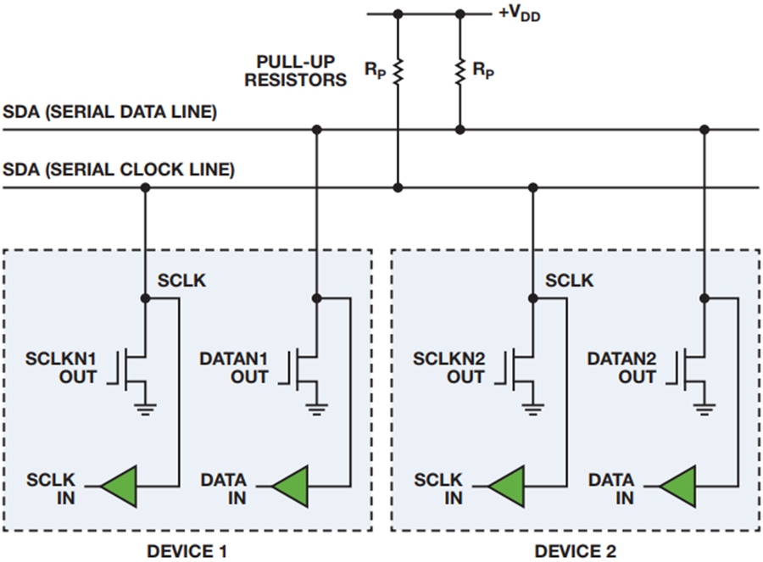
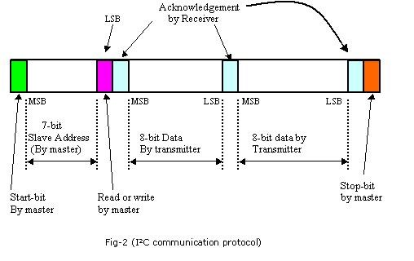
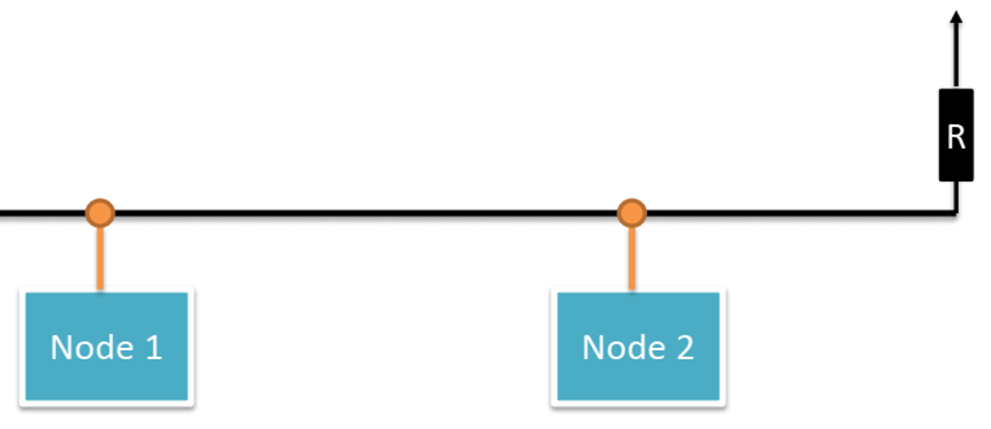
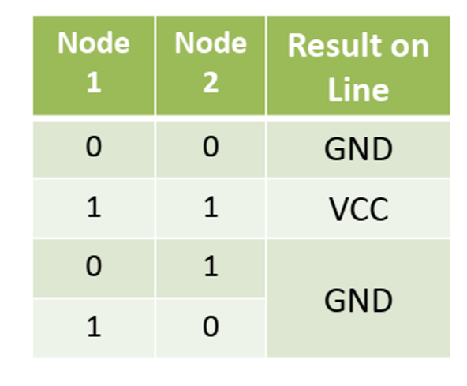
5- I2C

Slide 23
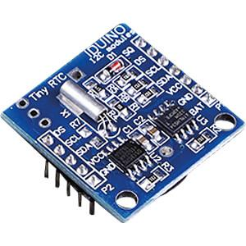
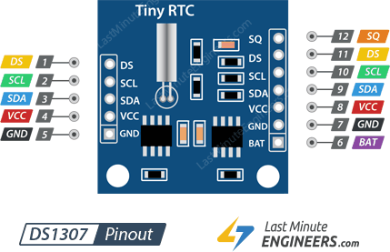
6- RTC
The DS1307 serial real-time clock (RTC) is a low-power, full binary-coded decimal (BCD)
clock/calendar plus 56 bytes of NV SRAM. Address and data are transferred serially through an
I2C, bidirectional bus. The clock/calendar provides seconds, minutes, hours, days, dates, months,
and year information. The end of the month date is automatically adjusted for months with fewer
than 31 days, including corrections for leap year. The clock operates in either the 24-hour or 12-
hour format with AM/PM indicator. The DS1307 has a built-in power-sense circuit that detects power failures and automatically switches to the backup supply. Timekeeping operation
continues while the part operates from the backup supply

Slide 24
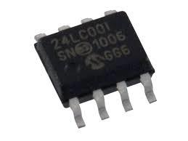
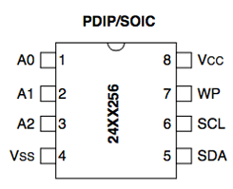
7- EEPROM
• EEPROM is electrically erasable programmable read-only memory.
• EEPROM is a nonvolatile memory.
• Atmega32 has an internal 1024-byte(1Kbyte) EEPROM.
• Any byte within an EEPROM may be erased and rewritten.
• Write/Erase Cycles(endurance): 100000 for EEPROM which is internal inside
atmega32.
• Fast to read not to write.
• Data retention: 20 years at 85°C/100 years at 25°C
• The primary tradeoff for this improved functionality is a higher cost to store
small amounts of data.

Slide 25
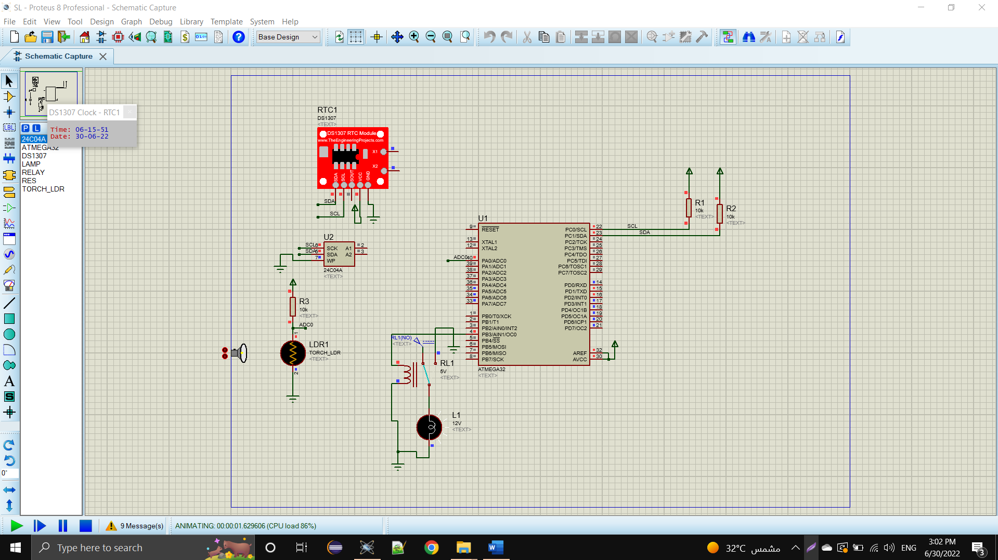
Simulation Results
Circuit Diagram

Slide 26
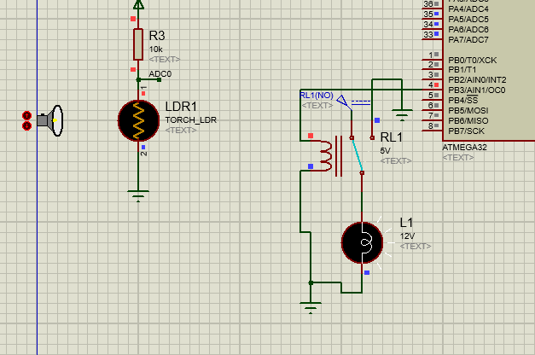
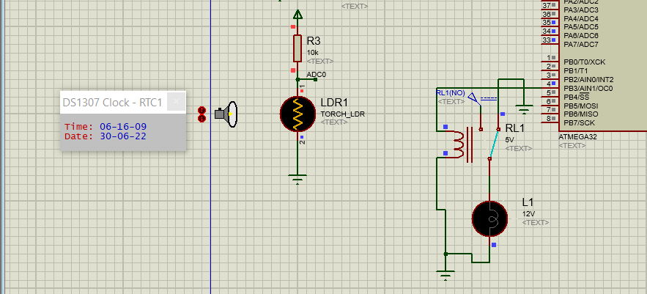
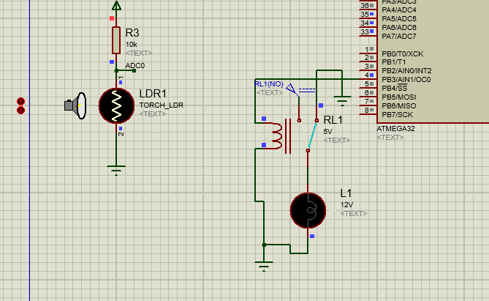
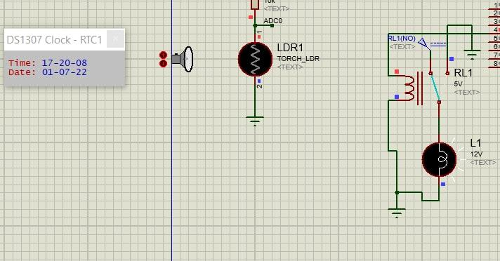
Circuit Performance During the Sunset and Low light intensity detected by LDR
Circuit Performance during the sunrise time
Circuit Performance During the Sunset and high light intensity detected by LDR
Circuit Performance during the Sunset time

Slide 27
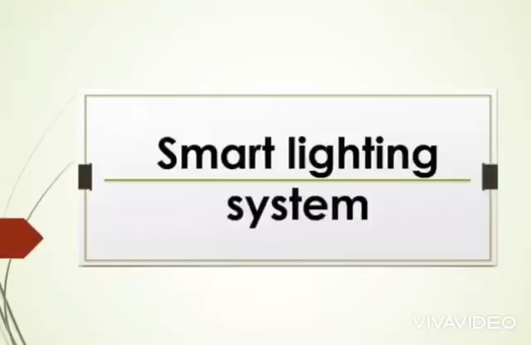
Test HW

Slide 28
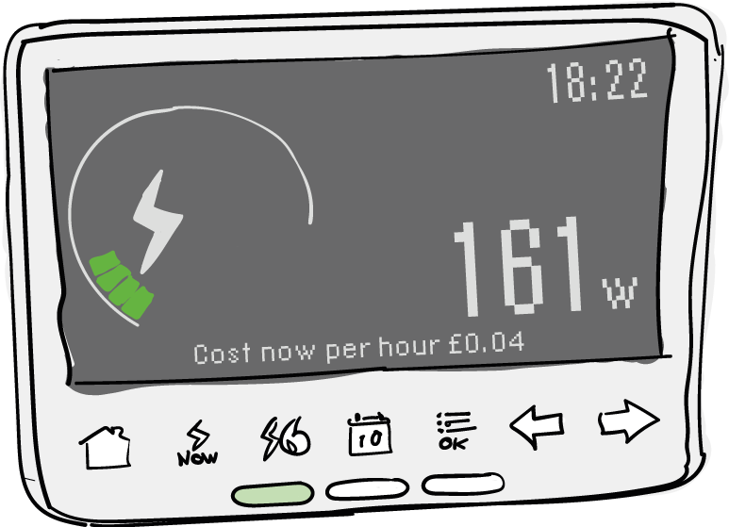
2- Smart Metering system
An electronic device that records information such as consumption of electric energy, voltage levels, current, and power factor.
Communicate the information to the consumer for greater clarity of consumption behavior, and electricity suppliers for system monitoring and customer billing

Slide 29
Top Level
Current
transformer
Rectifier
microcontroller
LCD
Phase shift measurement circuit
Cloud
Control
Center
Voltage
transformer
Rectifier

Slide 30
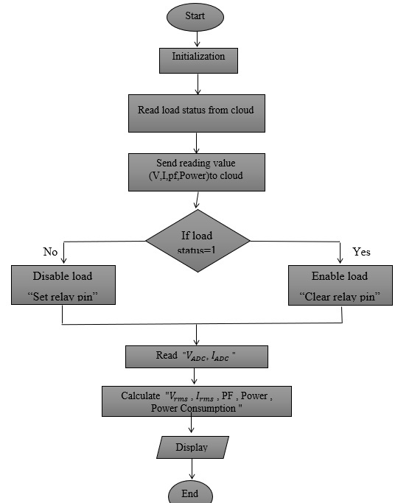
System Flow Chart

Slide 31
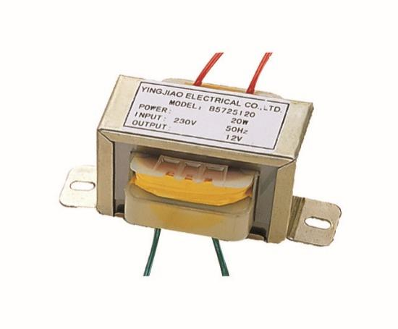
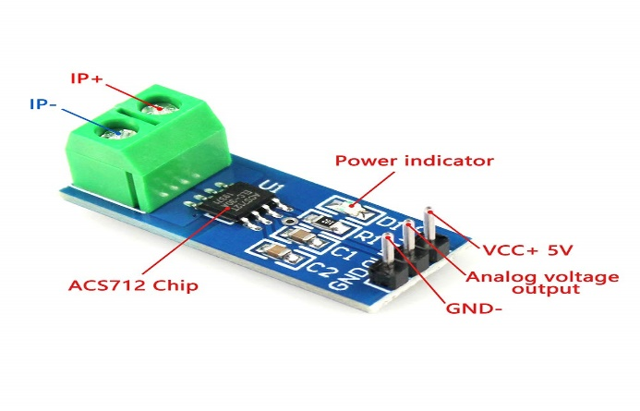
Hardware tools
1-Microcontroller ATmega32 2- Potential Transformer
3- ACS721 Current Sensor

Slide 32
1- Measure Voltage , Current and Power Factor
2- Calculate energy consumption
3- Display information to consumer
4- Full Control
Consists

Slide 33
1- Measure Voltage , Current and Power Factor
01
Measure Voltage
Steps
1-Step down the AC voltage (using transformer 220 - 12v)
2-Convert the AC voltage into DC (Using rectifier)
3-Give it to micro controller for Calculation

Slide 34
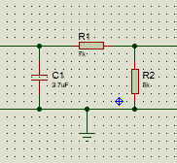

Circuit Analysis (calculate values of resistors and capacitors(
For ideal mode in atmega Current should be 1mA
Target to get $V_{o}$ = 5v (max volt to MCU)
$V_{in}$ = 12v , $I_{mcu}$= 1mA.
$R_{2}$ = $\frac{5}{1mA}$ = 5 K$Ω$
V= IR
($R_{1}$+$R_{2}$) = $\frac{V}{I}$ = $\frac{12}{1mA}$ = 12 K$Ω$
$R_{1}$= 7 K$Ω$
$X_{c}$ = $\frac{V}{I_{c}}$ ,$I_{C}$ + $R_{c}$ = 0 ,$I_{C}$=1mA
$X_{c}$ = $\frac{12}{1mA}$ =12 K$Ω$
$X_{c}$=$\frac{1}{W_{C}}$
C = $\frac{1}{2π∗50∗12000}$ = 2.653 uF

Slide 35
02
Measure Current
Steps
1-Step down the AC Current
2-Convert the AC Current to AC voltage
3-Give it to micro controller to Calculate
4-Calculate Load Current.

Slide 36
ADC

Slide 37
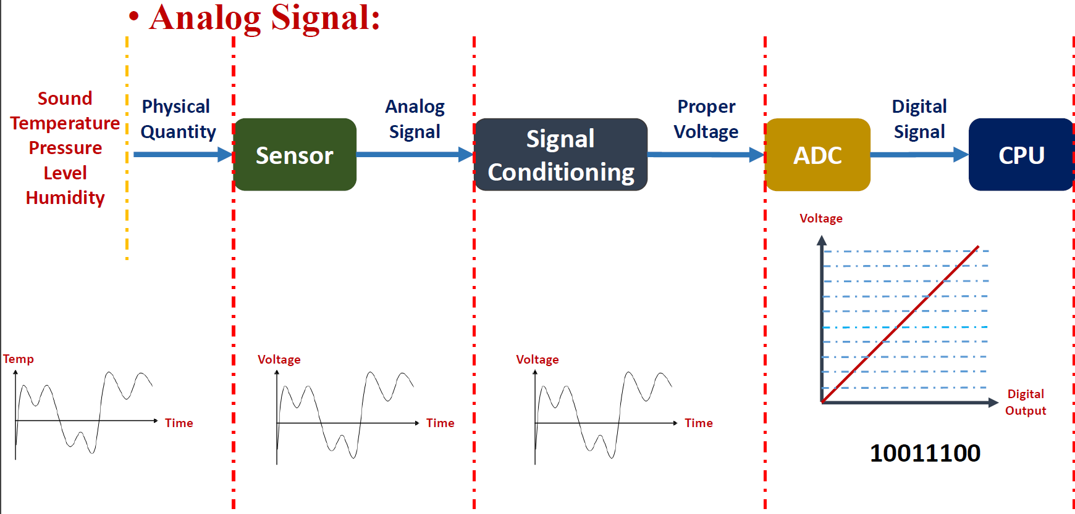
Analog to digital converter (ADC)
As we deal with a digital controller we need an ADC to convert the physical quantity (continuous in value ) to a digital code (discrete value) to can process this quantity and control the physical world

Slide 38
Conversion theory of ADC
The conversion goes through 3 main steps
Sampling
Quantization
Coding
This conversion is done by the Successive approximation ADC that comes built in most of microcontrollers as it is suitable for
low-cost
medium to high-resolution applications
low power consumption

Slide 39
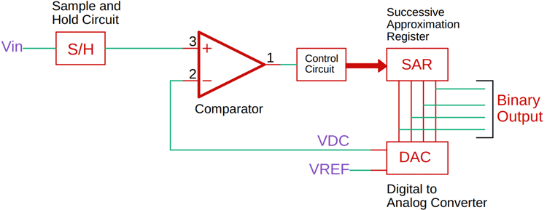
Successive Approximation ADC
This ADC consist of
A Sample and Hold circuit to acquire the input Voltage V_{in}.
An analog voltage comparator that compares V_{in} to the output of the internal DAC and outputs the result of the comparison to the successive-approximation register (SAR).
A successive-approximation register sub-circuit designed to supply an approximate digital code of V_{in} to the internal DAC.
An internal reference DAC that,
for comparison with V_{ref}, supplies
the Comparator with an analog
voltage equal to the digital code
output of the SAR_{in}.

Slide 40
working principle
The successive approximation register is initialized with (MSB) is equal to a digital 1.
This code is fed into the DAC, which then supplies the analog equivalent of this digital code (V_{ref}/2) into the comparator circuit for comparison with the sampled input voltage.
If this analog voltage exceeds V_{in}, then the comparator causes the SAR to reset this bit; otherwise, the bit is left as 1.
Then the next bit is set to 1 and the same test is done, continuing this binary search until every bit in the SAR has been tested.
The resulting code is the digital approximation of the sampled input voltage and is finally output by the SAR at the end of the conversion.

Slide 41
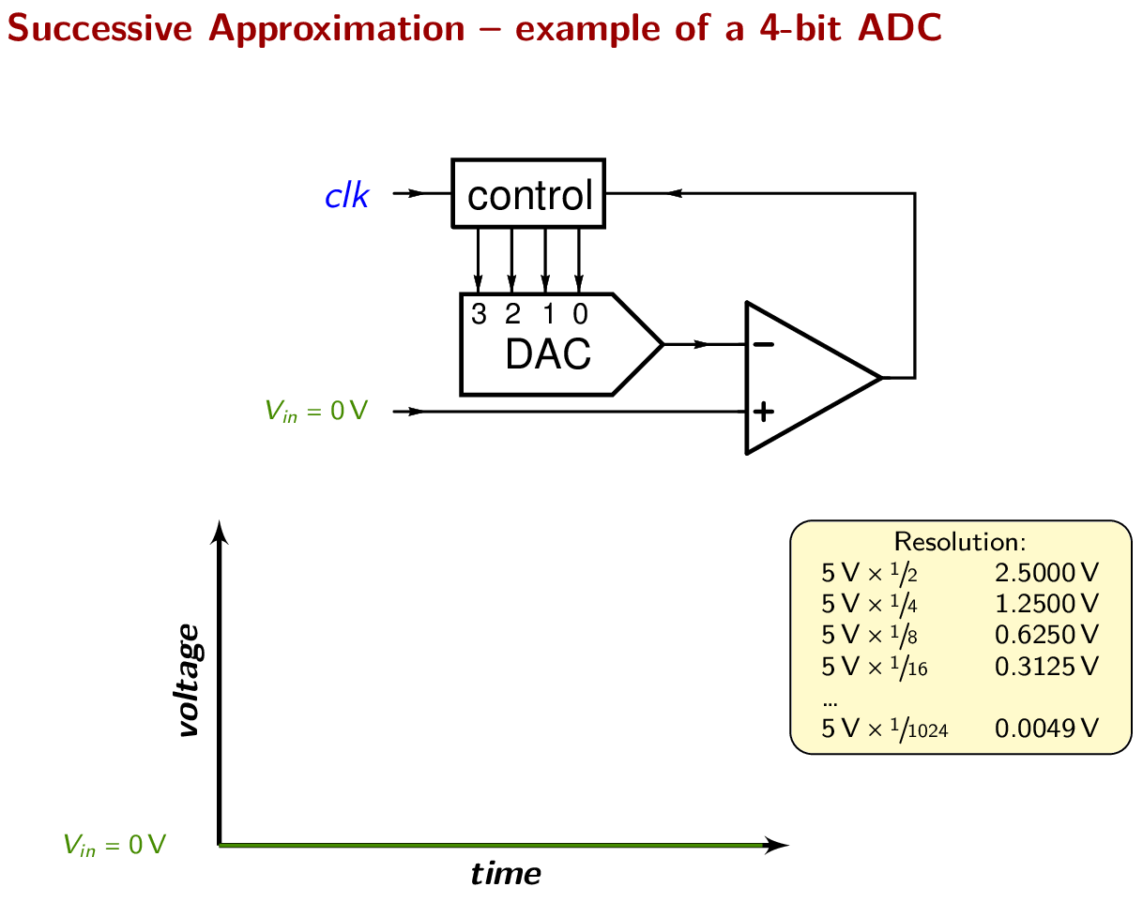

Slide 42
ADC Configurations
ADC is supplied with the AVCC (5V) as voltage reference
The resolution is 10-bit
The supplied clk from the MCU which is 1MHZ can be prescaled from ADCSRA reg in our case we used a 1/16 prescaler so
ADC Frequency = F_cpu / Prescaler = 1Mhz / 16 = 62.5KHZ
Conversion Time = 1/ADC Frequency
= 1/62500
= 16 Micro Second.
13 ADC Cycles Required For One Conversion
13 * 16 Micro Second = 230 us[Approximately]

Slide 43
For these confgs to calculate single ended conversion, the result is
Resolution = 5V/ 1024 = 4.88 mV
ADC =Vin / Res = Vin * (1024 / 5V)
which is the content in the ADCL & ADCH regs

Slide 44
3
Measure ᴓ
The power factor is basically “angle cosine of that lagging current “ current is lagging by voltage with some angle and if take cosine of that angle we will get power factor: Power factor = Cos (θ)
We will use zero cross detection to measure phase angle difference between voltage and current wave form. because it is easy to implementation and easy in calibration.

Slide 45
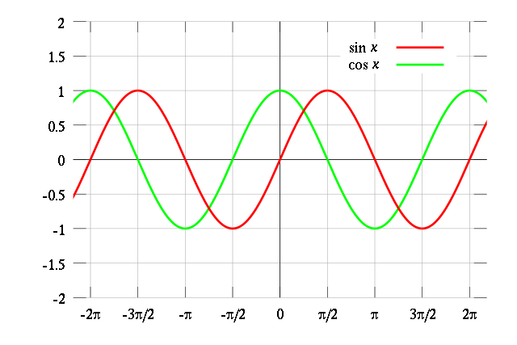
Zero crossing detection
Sine wave cross from positive cycle to negative cycle or negative cycle to positive cycle. enable us to measure the time between voltage and current .
In this technique we get a high value (one) whenever a zero will cross the system. So we can detect zero crossing of sine wave with the help of simple operational amplifier as comparator (LM358).

Slide 46
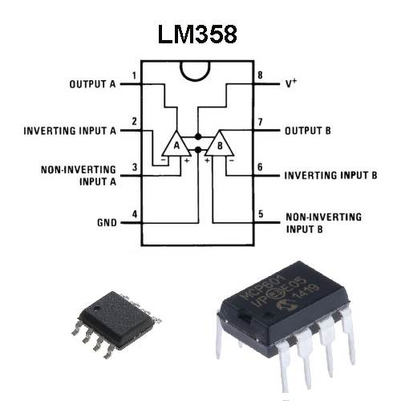
LM358
simple operational amplifier IC
compare high value (one)when zero crossing occur with low value (0) .
Use two LM358 as two zero crossing detection circuits are used. One for voltage wave form and other for current wave form

Slide 47
TIMER0
single channel counter
8_ bit timer/counter module
10-bit clock pre-scaler
Overflow interrupt source

Slide 48
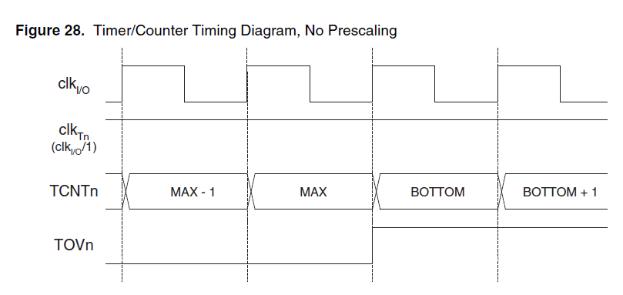
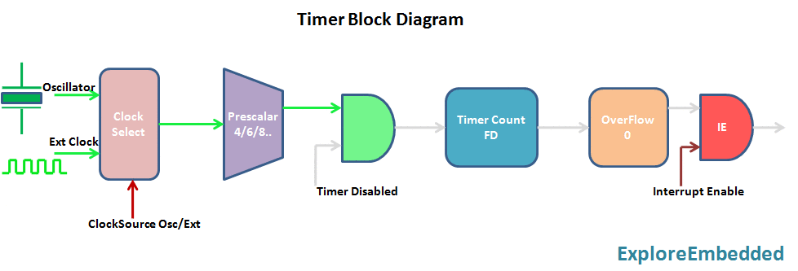
How It Work :

Slide 49
Timer 0 to measure time difference :
using interrupt pin and Timer to measure number of count :
first interrupt when detect zero crossing of current wave and timer start count .
Second interrupt when detect zero crossing of voltage wave and timer stop count .
Timer value = time different between two wave .

Slide 50
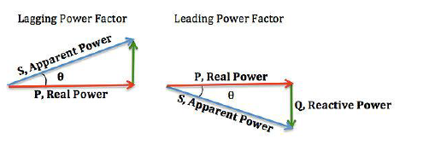
Define angle using time difference :
To covert it into second
t = average value of timer/1000000(timer frequency )
Find our require angle
θ= 360 *frequency (60)*t
Power factor = Cos (θ)

Slide 51
Interrupt
Interrupt Request
Background
Save CPU Context
Background
User ISR Code
Restore CPU Context
Interrupt Latency
Interrupt Response

Slide 52
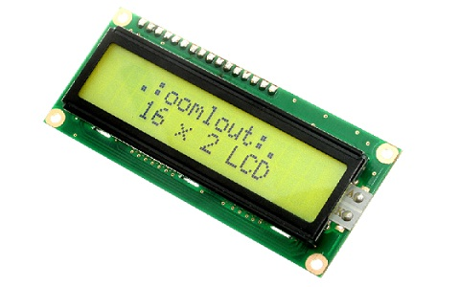
3- Display information to consumer
16×2 LCD to display all parameters. This display is nothing to do with the distribution company providing the electricity. LCD is for the consumer to know its present status of units and other stuff like voltage, current or power factor.

Slide 53
4- Full Control
turn on or turn off the power on load according to power consumed by receiving commands from the Cloud server.

Slide 54
Testing and Validation

Slide 55
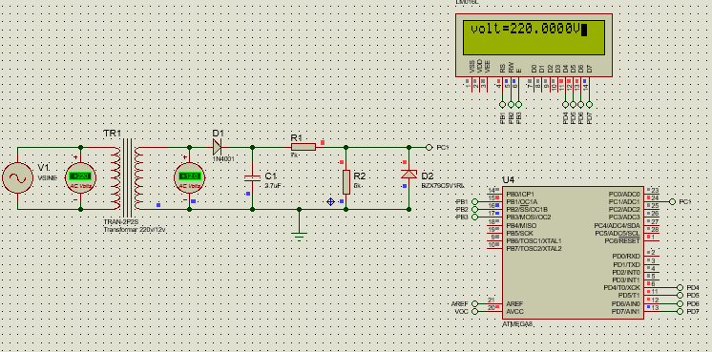
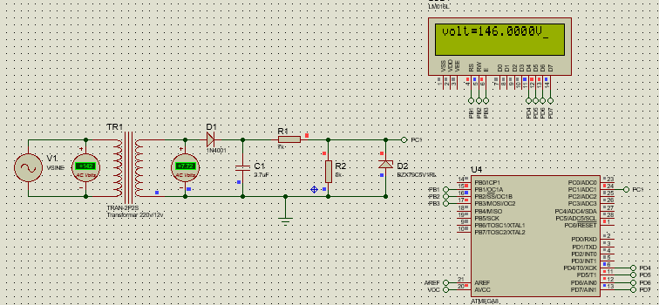
Simulation Results
(1) Voltameter testing
When amplitude= 311
Expected : 220
When amplitude= 200
Expected : 142

Slide 56


(2) Ammeter testing
When amplitude= 311
Expected= 12
When amplitude= 200
Expected= 7.72

Slide 57


(3) Power Factor testing
When phase between voltage and current = 0, Expected value= 1
When phase between voltage and current = 90, Expected value= 0

Slide 58

(4) Smart Metering System
Circuit Diagram

Slide 59

Test HW

Slide 60
3- Smart Parking System
Objective:
Smart Parking helps to manage the cars and provides some sort of security and data collection to help in the future.
Each user will have a unique ID on his RFID Tag.
This Tag is what will be used to pass the gate.
The System will save the time of the car entering the system and the driver’s ID.
When the car is leaving we scan the ID again to save the time and date of leaving.
This helps if any urgent need to information about drivers in the future.
Smart Parking
Exit
Gate
Entrance Gate
Main ECU

Slide 61

Top Level

Slide 62
Admin: (who has access to control the system information)
ADD user: Add a new user to the system by getting the ID from Keypad.
Delete user: Delete a user from the memory of the system.
Delete all users: from the system.
Main Program:
Receiving the ID through the I2C Bus from the Gates.
Search the ID in the System Memory.
If the ID is found return OK to open the gate.
If not return not Ok.
Main ECU
Main ECU
Admin Mode
Main Program Mode

Slide 63



Main Flow Chart

Slide 64

Main ECU

Slide 65
Gates
Entrance gates and Exit gates:
Two cases 1- the ID is authorized
2- the ID is unauthorized

Slide 66

Gates Flow Chart
1) Entrance Gates

Slide 67

2) Exit gates

Slide 68

Hardware tools
I2C
PWM
EEPROM
Key Pad
LCD
Servo Motor
• A servo motor is an electronic circuit for controlling the direction of
rotation, as well as the position, of the motor shaft.
• There are two types of servo motors AC and DC servo motors

Slide 69
Radio-Frequency Identification (RFID)

Slide 70


What is RFID?
Radio Frequency Identification (RFID) is the wireless non-contact use of radio frequency waves to transfer data. RFID systems usually consist of RFID reader, RFID tags, and antennas.
RFID reader
RFID tag

Slide 71
How does RFID work?
Every RFID system consists of :
1- Scanning antenna
2- Transceiver
3- transponder
The transponder is in the RFID tag itself.
Both Scanning antenna and transceiver are combined and form the reader
RFID tags contain an integrated circuit and an antenna, which are used to transmit data to the RFID reader when the reader requests the data from the tag.
The reader then converts the radio waves to a more usable form of data.
Information collected from the tags is then transferred through a communications interface to a host computer system, where the data can be stored in a database and analyzed at a later time.

Slide 72
A Reader consists of a Radio Frequency module and an antenna which generates high frequency electromagnetic field.
On the other hand, the tag is usually a passive device, meaning it doesn’t contain a battery. Instead it contains a microchip that stores and processes information, and an antenna to receive and transmit a signal.
To read the information encoded on a tag, it is placed in close proximity to the Reader (does not need to be within direct line-of-sight of the reader).
The reader generates an electromagnetic field which causes electrons to move through the tag’s antenna and subsequently power the chip.
The powered chip inside the tag then responds by sending its stored information back to the reader in the form of another radio signal.
This is called backscatter. The backscatter is detected and interpreted by the reader which then sends the data out to a microcontroller.

Slide 73

Applications of RFID
1. Institutions: Library, Hospitals, Schools, and Colleges
2. Transportation and Logistics
3. Access Control
4. Sports
5. Animal Tracking

Slide 74
RFID tags
Three different kinds of RFID tags are commercially available.
1) Passive tags: they do not have any power supply. They used to get their power from the incoming radio waves from the Readers.
2) Active tags: they have a power source for their internal circuitries. And for sending the response to the reader also, it uses its own power supply.
3) Semi-passive tags: which have a power supply for internal circuitries, but for sending the response it relies on the radio waves received from the Reader.

Slide 75
Operating Frequency
This RFID system is mainly operated in three frequency bands.
1) LF: Low-Frequency band
125 : 134 KHZ
Range up to 10 cm
2) HF: High-Frequency band
13.56 MHZ
Range up to 1 m
3) UHF: Ultra High-Frequency band
860 : 960 MHZ
Range up to 10 : 15 m

Slide 76

Working principle of HF RFID
First of all let’s see what is the simplified structure of an RFID Reader
RFID Reader

Slide 77

Simplified structure of RFID tag
RFID tag

Slide 78

The working principle for the HF RFID tags is: Inductive coupling (Near field coupling).

Slide 79


Slide 80
Technical Specifications of the module
Frequency Range | 13.56 MHz ISM Band
Host Interface | SPI / I2C / UART
Operating Supply Voltage | 2.5 V to 3.3 V
Max. Operating Current | 13-26mA
Min. Current(Power down) | 10µA
Logic Inputs | 5V Tolerant
Read Range | 5 cm

Slide 81
RFID in the system
We scan the tag to get the stored 4 byte ID
The challenge here is to deal with only one Byte to reduce the access time in the EEPROM ,so we used the block address 4 in sector 1 to store our own (1 byte) ID for each driver (user) among of the 1 KB of the internal memory.

Slide 82


Internal memory map of the tag

Slide 83
Serial Peripheral Interface (SPI)
High speed
high throuput
synchronous
Full-duplex
Framless
Single Master / multi slave

Slide 84


SPI Interfacing

Slide 85





How SPI works ?
MOSI
MISO
CLK
Slave
Master
SS

Slide 86

Simulation Results
• When the App first runs the HMI(LCD) prompts the admin to set a password for the
system which will be used to give access to the admin to control the system. • Password will be saved to the Non-volatile EEPROM

Slide 87




asks for running system or run as admin
wrong password
3 times wrong password
After Login with a verified password Admin now can
1- Add user
2- Delete user

Slide 88

Gates
Case : No Car

Slide 89

Case : There’s a car - Ask Id

Slide 90

Case : Authorized id

Slide 91

Case : Unauthorized id

Slide 92

System

Slide 93

Test HW

Slide 94
AI Systems

Slide 95

1- Face Mask Detection

Slide 96

System Architecture

Slide 97

System Flow Chart

Slide 98


Control Part

Slide 99
AI Model

Slide 100

Convolutional Neural Network (CNNs)

Slide 101

How CNNs Work

Slide 102


Dimension Reduction:
Max Pooling
Average Pooling

Slide 103


How CNNs Work

Slide 104



Activation Functions

Slide 105



Model Results
Final Model Confusion Matrix
Final Model ROC Curve
Final Model Train and Loss curve

Slide 106

2- Auto Attendance System

Slide 107

System Architecture

Slide 108

System Flow Chart

Slide 109

Face Recognition Pipeline.

Slide 110




Used Libraries

Slide 111
Cloud

Slide 112

Introduction
An IoT cloud is a massive network that supports IoT devices and applications. This includes the underlying infrastructure, servers and storage, needed for real-time operations and processing. An IoT cloud also includes the services and standards necessary for connecting, managing, and securing different IoT devices and applications.

Slide 113


Tools
NodeMCU
IOT Platform Thingspeak

Slide 114

NodeMCU
NodeMCU is an open-source LUA-based firmware developed for the ESP8266 Wi-Fi chip.
it’s
open source
powerful

Slide 115

IOT Platform ThingSpeak
ThingSpeak is an IoT analytics platform service
works with Arduino, Raspberry Pi and MATLAB .
allows :
aggregate
visualize
analyze live data streams

Slide 116

SoftWare
Arduino IDE
The open-source Arduino Software (IDE) makes it easy to write code and upload it to the board.

Slide 117

GUI : Web pages
We used an html to create a web page to display and visualize the collected data and CSS to beautify the web page and json parse to get and post data to and from the cloud and here is what our pages look like under test of the system.

Slide 118
Communication protocol between NodeMCU and ATmega

Slide 119
USART (Universal Synchronous Asynchronous Receiver Transmitter)
Full duplex
in synchronous mode, or in asynchronous mode.
Serial communication interface
Double Speed Asynchrones Communication Mode
High Resolution Baud Rate
Pear to pear no master
Data is transmitted as frames

Slide 120

UART frame

Slide 121
Framing Error Detection

Slide 122
Communication between NodeMCU or Websites and Cloud

Slide 123


HTTP Request
HTTP requests are messages sent by the client to initiate an action on the server.
Types used :
1- Get
2- Post
HTTP Request
HTTP Response

Slide 124
Get Request
used to read From Server.
Formatting : Get / URL
URL: https://api.thingspeak.com/channels/Channel_ID/api_key=Read_Api_Key
Responses
In case of success (or non-error) : 200
In an error case:
NOT FOUND : 404
BAD REQUEST : 400

Slide 125
Post Request
used to Write to Server.
Formatting : Post / URL
URL: https://api.thingspeak.com/update?api_key=Write_Api_Key&field1=Data
Responses
In case of success (or non-error) : 200
In an error case:
NOT FOUND : 404
BAD REQUEST : 400

Slide 126
Systems

Slide 127

Smart Lightening
Flow chart

Slide 128

web page

Slide 129


Test

Slide 130

ThingSpeak Channel

Slide 131

Smart Metering
Flow chart

Slide 132

web page

Slide 133


Test

Slide 134

ThingSpeak Channel

Slide 135

Smart Parking
Flow Chart

Slide 136

web page

Slide 137

Test

Slide 138

ThingSpeak Channel

Slide 139
Printed Circuit Board (PCB).

Slide 140

What are PCBs ?
PCBs are the backbone of electrical devices.
PCB supports all and electrically connects electronic components using conductive tracks, pads and other features etched from copper sheets laminated onto a nonconductive substrate
The PCBs are non-conductive board that holds all electronic components.

Slide 141

Why we use PCB ?
easy of use and safety from electrical hazards in the workplace.
PCB solves the problems of Bread Board like :
More jumpers are used in big circuits so it will be complex.
Troubleshooting circuit is very hard.
Very sensitive to external interferences.
Connections will not be firm.

Slide 142

PCB Types
Single Sided : clads with copper on one side as we can connect on this only side.
Double sided : clads with copper on its both sides as we can connect the components on the two sides.
Multi Layered : several layers of substrates. Each layer is separated by an insulation.

Slide 143

Parts Of PCB
Components.
Pads.
Traces.
Vias.
Top Metal Layer.
Bottom Metal Layer.

Slide 144

Components
Components are the actual devices used in the circuit. This includes i/o connections, I/O ports including power supply connections.
Components can be categorized as Active and Passive.
Active Components include : Diode , Transistor, ICs.
Passive Components include : Capacitor, Resistor, Inductor.

Slide 145
Package Types
PCB components can be mounted onto the board in two ways :
Surface Mount : PCB components are mounted directly onto the board.
Through-Hole : Components with leads are inserted through mounting holes.

Slide 146

Designing Process of PCBs
Step1 : Design the PCB Circuit with a Software.
Draw the schematic circuit diagram with PCB layout software.
Using EasyEDA software as it is free and online using and it contains a library of components that is used to build the circuit.

Slide 147

Designing Process of PCBs
Step2 : Film Generation
The film is generated from the finalized circuit board diagram of the PCB layout software which is send to the manufacturing unit where the negativee image or mask is printed out on a plastic sheet.

Slide 148

Designing Process of PCBs
Step 3 : Select Raw Material
The bulk of the printed circuit board is made with an unbreakable glass or fiberglass.
Step 4 : Preparing Drill Holes.
Step 5 : Apply Image.

Slide 149


Designing Process of PCBs
Step 6 : Stipping and Etching
Step 7 : Testing
After finishing the manufacturing process of the Printed Circuit Board. The Board undergoes a testing process to check whether the PCB is working properly.

Slide 150


Schematic for Systems
Smart Meter.
Smart Light.

Slide 151


Schematic for Systems
Main. Gate.

Slide 152


Layout for Systems

Slide 153


Layout for Systems

Slide 154


3D View for Systems

Slide 155


3D View for Systems

Slide 156
Thank you!

